Slide 1



Innovative Project Lab for CSBS
LIFESTYLE CHATBOT

Slide 2
Abstract
A Chatbot is a computer operating system which spark the person’s discussion between voice message or live chats. Chatbot, is made up of artificial intelligence that can be inserted and can be used for many major applications. This interacts between people and user, which increases customer experience. This chatbot makes you to feel good about your day and it will boost up your mind in any situation like happy, sad, tired or lazy. And it even tells about importance of food to have on time without skipping. This bot has Facebook integration and done through software called chat fuel. This makes the user think that they are chatting with a human being (like we share our feelings with friends) but where we are chatting with computer.
And it helps every individual to overcome their stress, workload, etc.…it’s like relaxation chat. Nowadays people started to take medicines for their stress, for peace of mind. This will chatbot will avoid these problems and get you, to know you better.

Slide 3
Need for the Proposed System
I prepared chatbot which helps users to know about their state of mind through emotions
like happy, sad, tried, lazy, etc., so first the user should answer the quires like did you had your breakfast, lunch or dinner and then the chatbot will tell them importance of breakfast, lunch or dinner importance if they skipped it.
And then the user is asked to select how you are feeling today like happy, sad, tired or lazy.
Users select any button means different ways method pop up to boost your mind.

Slide 4
Advantages of the Proposed System
Know their state of mind
.Get to them more better
Know about their interest and what they are excited for
And favorite things they like the most…

Slide 5
Main Objective
The objectives of the following would be based on outcomes of the project.
To give temporary relief to the people who are more stressed from workload, family problems and to have proper sleep cycle and to boost up the mind.
To prevent the people from taking medicines for sleep and reducing stress which creates many side effects and depression.
To provide interaction with user who might be sad or tired, which change their state of mind and be happy and do what things they like the most and peaceful mind.
To give hope to the people that the everything is fine and everything happens for reason and we should be a sun for our life not darkest night.

Slide 6
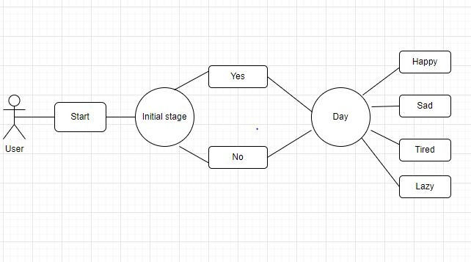
Architecture

Slide 7
Functional Description
BOT CREATION
The bot consists of lifestyle bot which deals with features, integrations available in the bot. The bot has a pop-up messenger when the website is opened which displays a welcome message and with block and flows. The bot will have access through a button option. Then the bot is connected to Facebook page and the bot link is created.
CHATFUEL MESSENGER
The messenger bot appears as a pop-up with a welcome message when the user accesses the website. The messenger bot is inbuilt with rich messages like button options, images, video, audio, redirect, etc. Through this feature we can add buttons, images, videos, audios, live chat, chips that direct you to welcome message new page. It enhances the feature of the bot and attracts the user.

Slide 8
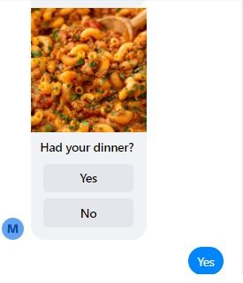
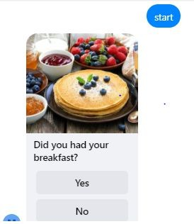
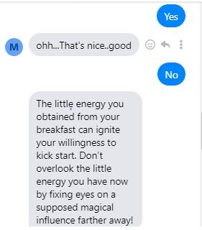

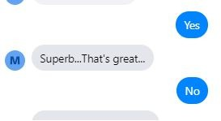
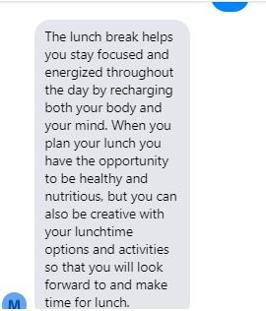
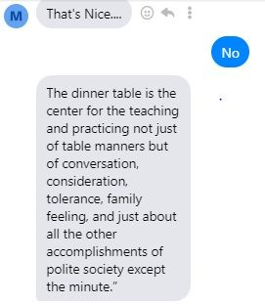
Implementation and Testing
Initial pages

Slide 9
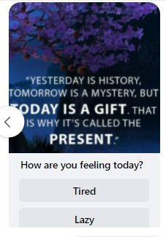
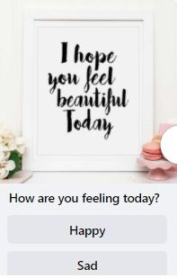
Implementation and Testing
How you are feeling today?

Slide 10
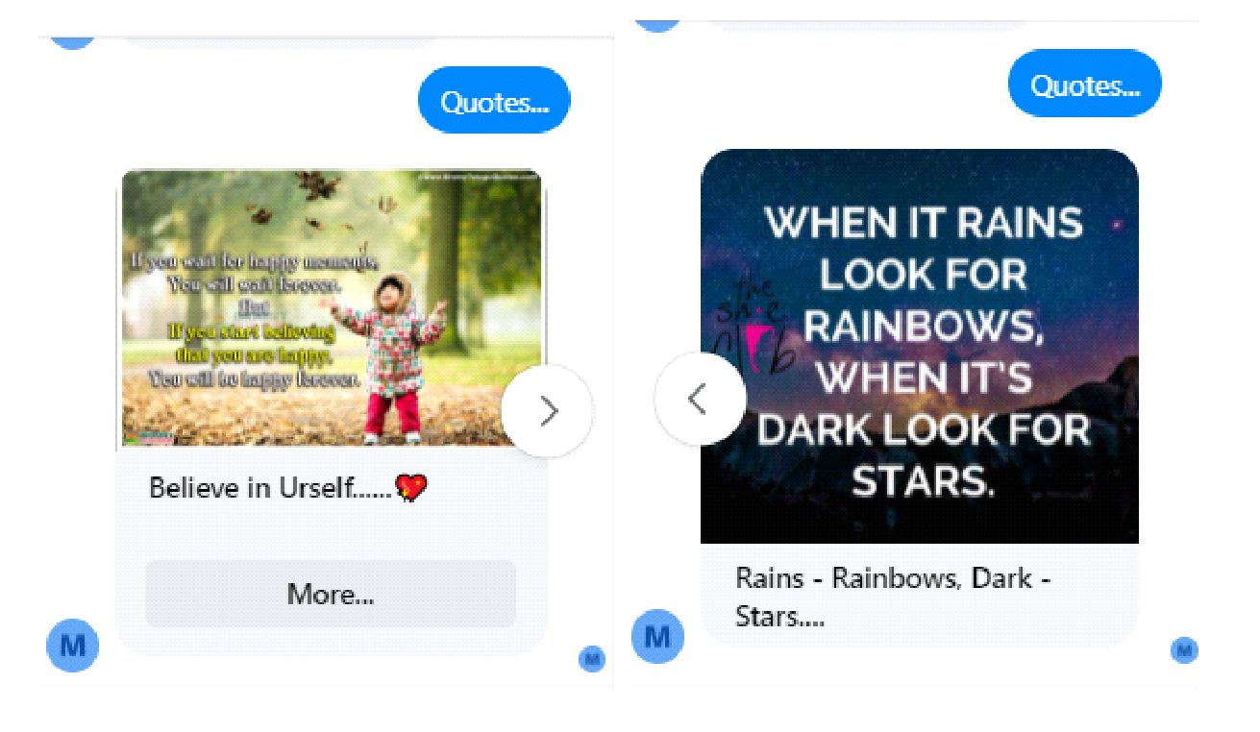
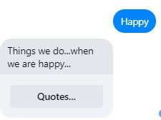
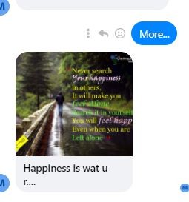
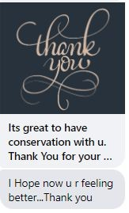
Implementation and Testing
If the user select happy… Quotes…

Slide 11
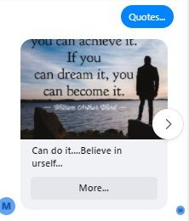

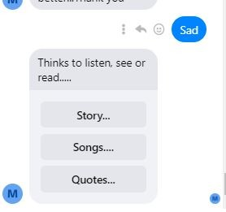
Implementation and Testing
If the user select sad means….. Quotes..

Slide 12
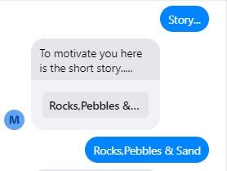
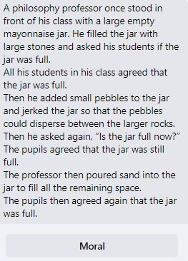
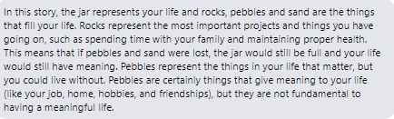
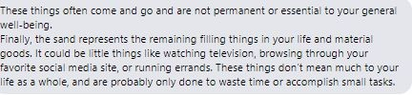
Implementation and Testing
Sad- story….

Slide 13
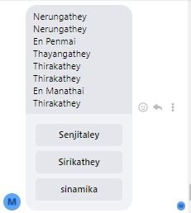
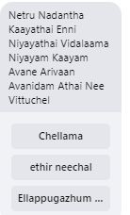
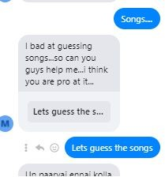
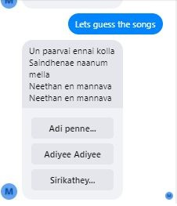
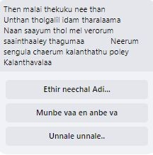
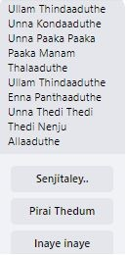
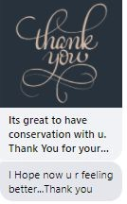
Implementation and Testing
Sad – songs….

Slide 14
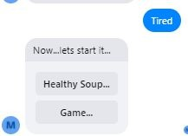
Implementation and Testing
If the user select tired..

Slide 15
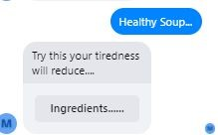
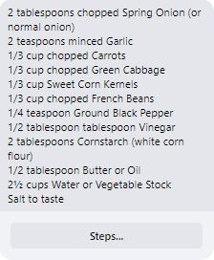
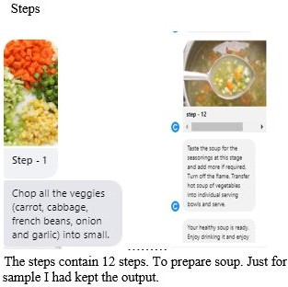
Implementation and Testing
Tired – Healthy soup

Slide 16
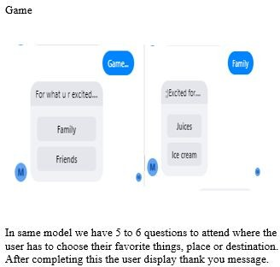
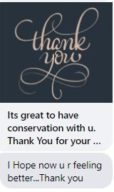
Implementation and Testing
Tired – Game

Slide 17
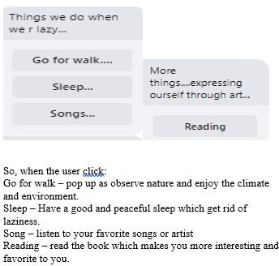
Implementation and Testing
If user selects lazy means….

Slide 18
Conclusions
Chatbots or smart assistants with artificial intelligence are dramatically changing businesses. Chatbots can reach out to a large audience on messaging apps and be more effective than humans. They may develop into a capable
information-gathering tool in the near future. Chatbots are a new, emerging space. This project helps the user to get know their day better and boost up their mind in whatever situation they are. As the project allows user of an every individual to choose their choice, activities and emotions which increases their lifestyle and health well-being.

Slide 19
Future Enhancement
The future scope is now the chatbot is only available for Facebook login that is
messenger. So in future we can develop for all social media app like Instagram, etc
And we can check whether we can be able to be add videos or audios in the chatbot and give like motivational speech or video.

